Slide 1





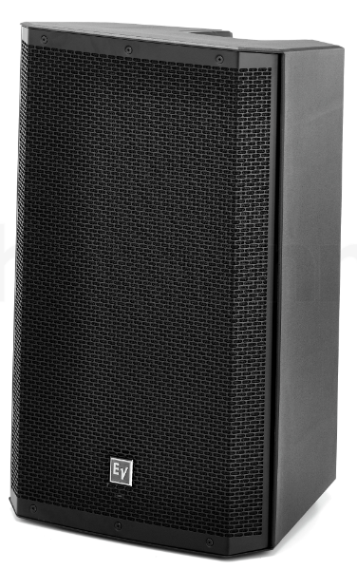
PROJECT FRAME Infra Timeline 05/2024 + Link PowerBI

Slide 2
Infrastructure Timeline
Project FRAME:
 | 2024 |  |  |  |  |  |  |  |  |  |  |  | 2025
 | JAN | FEB | MAR | APR | MAY | JUN | JUL | AUG | SEP | OCT | NOV | DEC | JAN | FEB | MRZ | APR | MAY | JUN | JUL
Major Milestones
Preparation
LAN / WAN
Server Services
Digital Workplace, including M365 + Azure + Telephony
Preparation
Implementation
Stabilization
Frozen Zone
IT Kick-off
Signing
Closing
Infrastructure Kick-off
Go-Live Active Directory
Server Mig.
Network Cut
CWP & M365 Build readiness
Go-Live M365 & Public Telephony
1
Concept preparation & site visits
Onboarding EDL
Concept finalization + HW Ordering
2
WAN Ordering
WAN implementation
LAN and Wi-Fi implementation
Implementation of Server Infrastructure
House- keeping
3
File Share Consolidation
Migration of Infrastructure Applications
Build CWP & M365 Env.
Clean-Up
Setup Public Telephony (Orange)
4
User & Group Sync to Target Domain
End to End Tests
M365 Data Sync
Client & User Mig.
VIP Mig.
M365 Cut-Over

Slide 3

Infrastructure Master Data Source in PowerBI
Project FRAME: IT Infrastructure
FRAME IT Infrastructure PowerBI

